Slide 1

Y2019 SALES ANALYSIS
2
+
2
+
THE SUNSHINE STORE
BY GABRIEL STEVEN O.

Slide 2
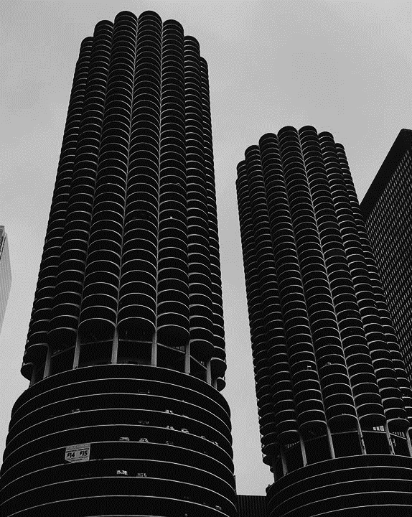
CONTENT
2
+
INTRODUCTION
METHOD
ANALYSIS 1,2,3
CONCLUSION
RECOMMENDATION

Slide 3
INTRODUCTION
A store wants to make a sales analysis so they employed the service of a data analyst to help them in this sales analysis, for the sake of clarity, we will be naming this store THE SUNSHINE STORE.
The sales data presented to the analyst is of the year 2019 and will be done with the help of some analytical tools in which we have to solve some problem statements and provide solutions to those problems, some recommendations will be made available too.
The method of the analysis of The Sun Shine store will be provided in the next slide followed by the analysis itself and with all these approaches, we will be able to come up with a concise conclusion and recommendation.

Slide 4
METHOD
Before explaining the method, we have to be aware of the problem statements that need solving by the store, that way, we can talk more on the methods we will employ to carry out the analysis.
PROBLEM STATEMENT
As the Analyst, you are tasked to utilize your analytical and presentation skills to uncover trends and patterns for the 2019 sales year. Generate key sales metrics.
Method: Firstly, the data has to be understood, and then it has to undergo data transformation and cleaning to ensure accurate analysis.
The Accountant reported that we made loss in the month of April, May, June and July as compared to other month. Is this true? What happened? Show monthly sales performance
Method: The accountant meant the total sales of the above mentioned months are lesser than the rest of the month, as the analyst, we will be finding out if that is in fact true or false.
The Assistant manager suggested that we should place more marketing attention on the following cities - Los Angeles, New York, Atlanta, San Francisco and Seattle as they seem to generate more revenue. From the result of your analysis, do you agree with this? Should we proceed with the suggestion?
Method: Basically, the assistant manager chose the top 5 cities with the highest total sales to come up with that suggestion but we have to check if truly, his choice of cities for marketing attention is right.

Slide 5
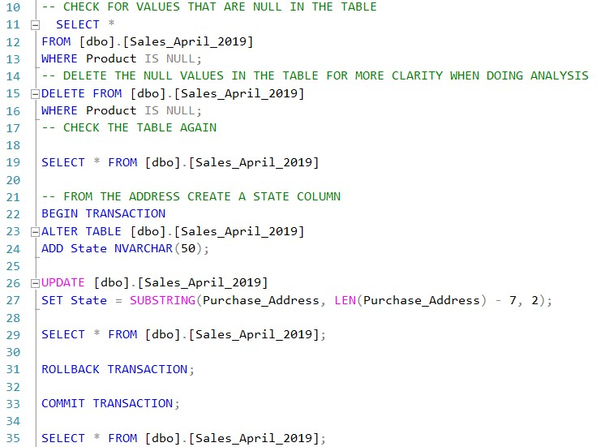
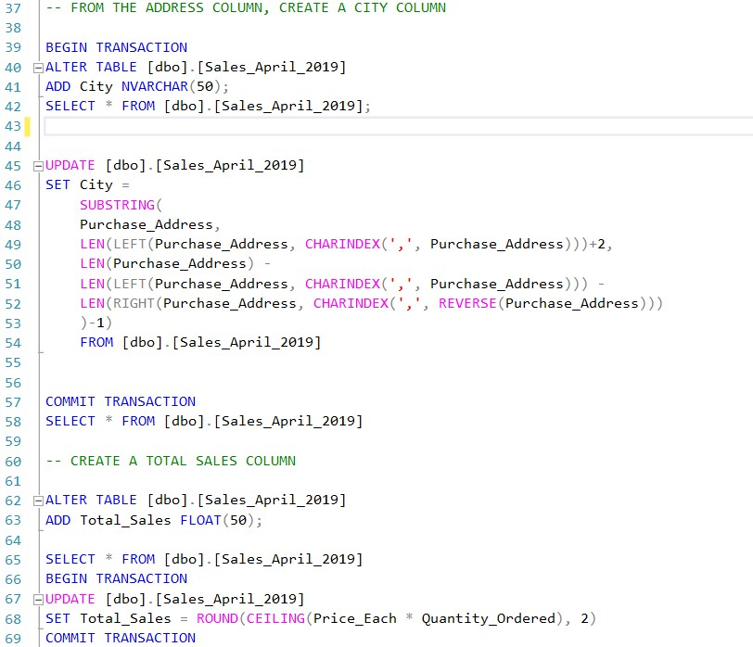
ANALYSIS 1
- As the Analyst, you are tasked to utilize your analytical and presentation skills to uncover trends and patterns for the 2019 sales year. Generate key sales metrics.
. To actualize this, SQL was used to do the necessary data transformation and cleaning because we can not draw out any meaningful insight from the original data. Some of the example of the cleaning are as follows.
After doing the transformation for each month, all the months were then merged together to form a single table which of course will come handy when doing our last analysis.

Slide 6
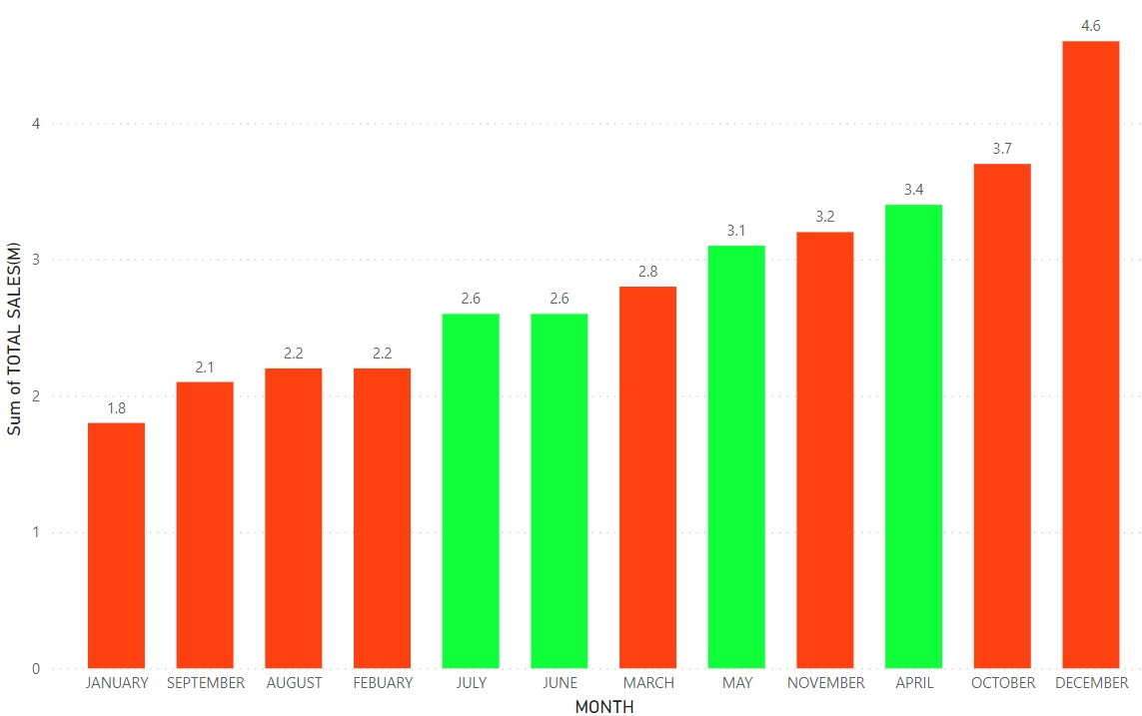
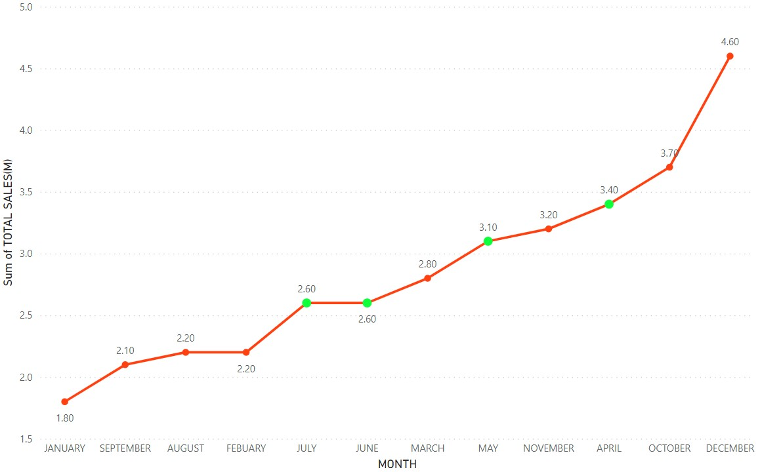
ANALYSIS 2
- The Accountant reported that we made loss in the month of April, May, June and July as compared to other month. Is this true? What happened? Show monthly sales performance
Firstly, we have to create a bar-chart that shows the Total sales of each months, that way we will be able to visually compare if truly we made loss in the above stated months.
From the above charts, the green bars are the total sales for the stated months (April, May, June and July). According to the accountant, we made loss in those months in comparison to the other months.
However, that is not the case, according to the other chart, we can see that there is an upward movement in the total sales trend, since the highlighted months are in a upward trend movement and there are four months with less sales than the first highlighted month, then it is false to say that we made loss in comparison with other months.
The case would have been different if the highlighted months are (January, September, August and February). That way, we will be confident about stating we made loss in comparison with other months.

Slide 7
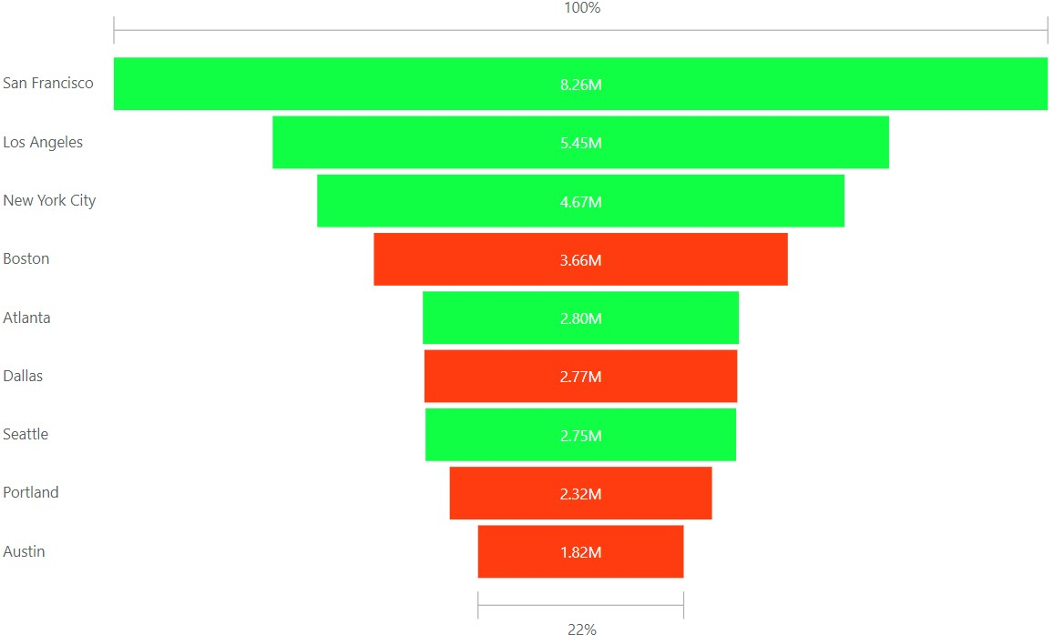
ANALYSIS 3
The Assistant manager suggested that we should place more marketing attention on the following cities - Los Angeles, New York, Atlanta, San Francisco and Seattle as they seem to generate more revenue. From the result of your analysis, do you agree with this? Should we proceed with the suggestion?
When talking about cities that generate more revenue, what the Assistant manager did or wanted to do was to highlight the top 5 cities with the highest sales, but was the manager right with mentioning the above cities? There is only one way to find out.
The five highlighted cities in the funnel chart are the cities the assistant manager claimed to be the cities that generate more revenue and should be given more marketing attention but in fact the assistant manager is not entirely right, if the manager wants to use cities that generate more revenue as a yardstick, then Seattle shouldn’t have been in the list, rather Boston should have been in place of Seattle since Boston made 3.66M while Seattle only made 2.75M.
Since we are choosing the top 5 cities that generate more revenue, the list should be (San Francisco, Los Angeles, New York City, Boston and Atlanta).

Slide 8
conclusion
2
+
After carefully analyzing the given data, we have been able to answer two of the most crucial problems given, we can see from the first problem being that the accountant analysis on the given months as being months of loss in comparison with other months is totally false but rather there are months with more loss than the accountant given months.
Also, the Assistant managers analysis on the cities to focus more in marketing is also wrong because he did not make the right analysis to choose the right cities.

Slide 9
RECOMMENDATION
2
+
The first recommendation is for the accountant not to carry out solo decisions cause there might be some flaws in his analysis, rather he carry out decisions with a team so all flaws and inconsistencies will be checked
Also the reason for the assistant managers analysis is to place marketing focus on the top 5 cities with the highest revenue generation and from the data analyst perspective, these five cities should include (San Francisco, Los Angeles, New York City, Boston and Atlanta) as they are in fact the top 5 cities that generate the highest revenue for the store.

Slide 10
THANK YOU
2
+
2
+
ANALYSIS BY GABRIEL STEVEN O.

